Slide 1


Visuals OF THE BOOKS DATASET
AKSHAY KAILASA

Slide 2
EXECUTIVE SUMMARY
CONTEXT:
The visuals makes more sense when given with information than the verbal data when summarized.
Different types of charts are used to present the data like the Bar Chart, Pie Chart, Line graphs, Whisker Plots, Maps and Tree Graphs etc.
​The extremes like rise and drops are well understood by using the visuals.
In the next slides, we presented the data with different types of visuals from which insights are found.​
KEY FINDINGS:​
Sci-Fi/Fantasy has the maximum book sales when compared to other genres. Highest number of books were sold in the year 1988.
United States has 9 Authors which is highest when compared to all other countries and German author Fleischman Darryl is in the top with respect to writing per hour.
Market Spent in 2020 with respect to genre Sci-Fi/Fantasy stands top with 36%. The publisher Not your mother has 89% of Market spent which is highest when compared to other publishers.
Hardcover average suggested retail price is more than all other formats.
Printing cost per book has increased significantly after 1988 and then dropped.
2
Data Visualization |Akshay Kailasa

Slide 3
The Book Sales will increase in 1992? In 1988 count of sales contribute 20.6% of total sales.
Sci-Fi/Fantasy Genre has maximum number of book sales with 36.4%.
Sales of books are dropped down every time after it hits highest point.
36%
3
Note : Published year of 1980,1981 are assumed are not present in data set .
Data Visualization |Akshay Kailasa

Slide 4
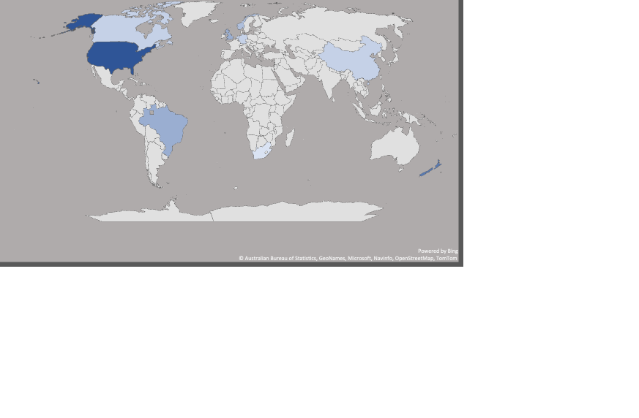
Country with a greater number of Authors The United States has 9 authors.
Authors how spent most of the time writing Books.
Fleischman Darryl has spent 16 hrs a day
23%
2
3
9
2
4
1
7
Note :In map when you hover on country which has blue color it will display count of authors
Right chart I have Considered top 5 Author’s hours from the data set. Difference percentage is between top 2 writings per hours.
4
Data Visualization |Akshay Kailasa

Slide 5
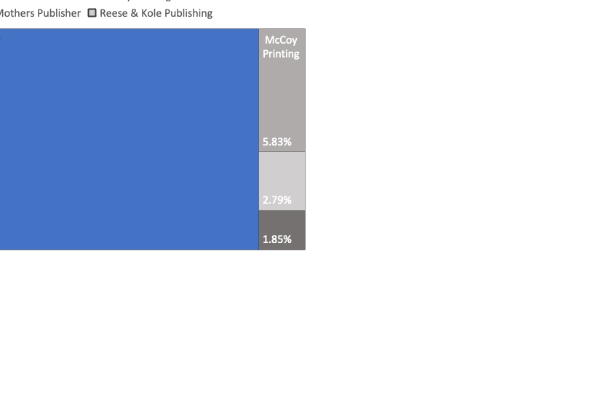
Sci-Fi/Fantasy genre has major market spent with 36% in 2020 will it continue..
Not Your Mothers Publisher has major market share which is 89.54%.
5
Note : Mystery, Nonfiction , Memoir and Young Adult Genre are considered as others
Data Visualization |Akshay Kailasa

Slide 6
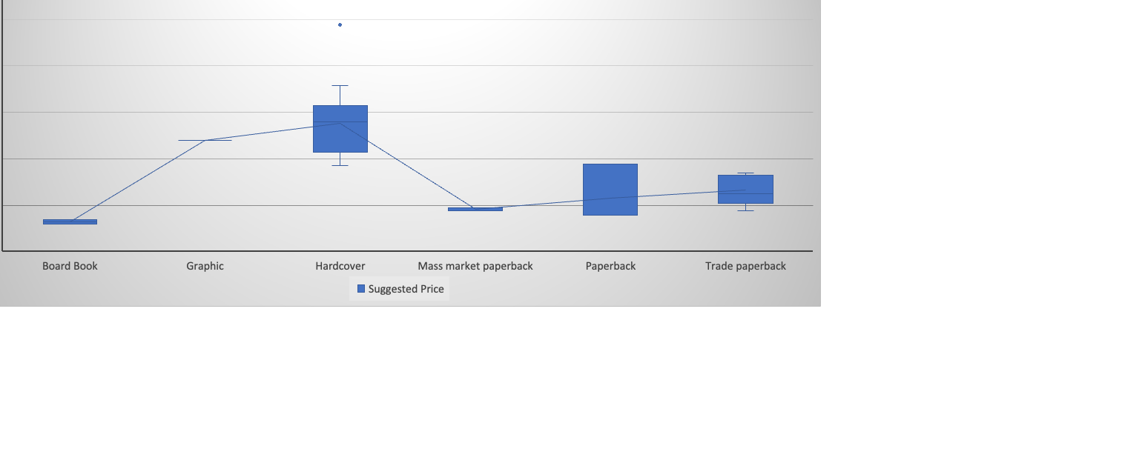
Across all the formats of books Hardcover has 15.4% higher than the average suggested retail price.
6
Note : Calculation based on average of all data points and average value of hardcover and pulled out the percentage difference .
Data Visualization |Akshay Kailasa

Slide 7
Printing Cost Per Book of Sci-Fi/Fantasy Genre after 1988 has risen to 62.8%
In both Segments after 1991 printing cost per book has dropped significantly.
7
Note: Comparing only Fiction and Sci Fi/Fantasy Genre only.
Data Visualization |Akshay Kailasa

Slide 8
APPENDIX
Slide 1: Title page
Slide 2 : Executive Summary
Slide 3: Count of Sales of Book with respective to Publish year and Genre
Slide 4: Authors Information with respective to countries and writing per day.
Slide 5: Market Spends Information
Slide 6: Suggest Retail Price across all the formats
Slide 7: Printing Cost Per Book
Slide 8: Appendix
Slide 9: Suggested Retail across the Series/Genre/author's name
Slide 10: Count of series across the Genre
8
Data Visualization |Akshay Kailasa

Slide 9
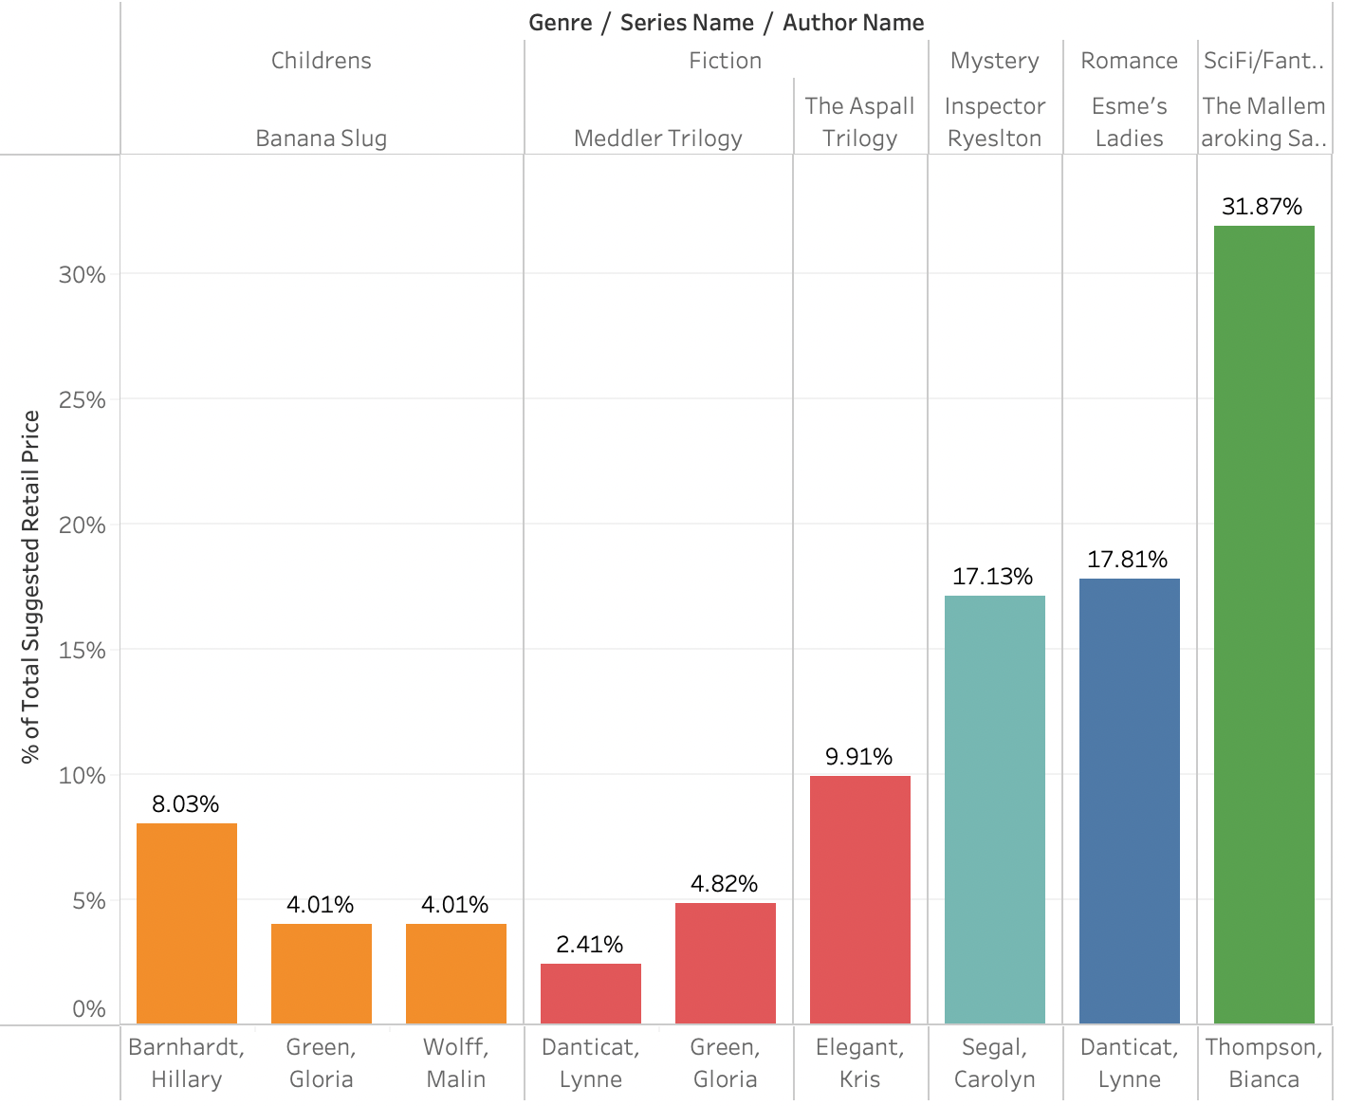
Suggested retail price across the Genre
The Mallemaroking Saga has 31.87%
9
Data Visualization |Akshay Kailasa

Slide 10
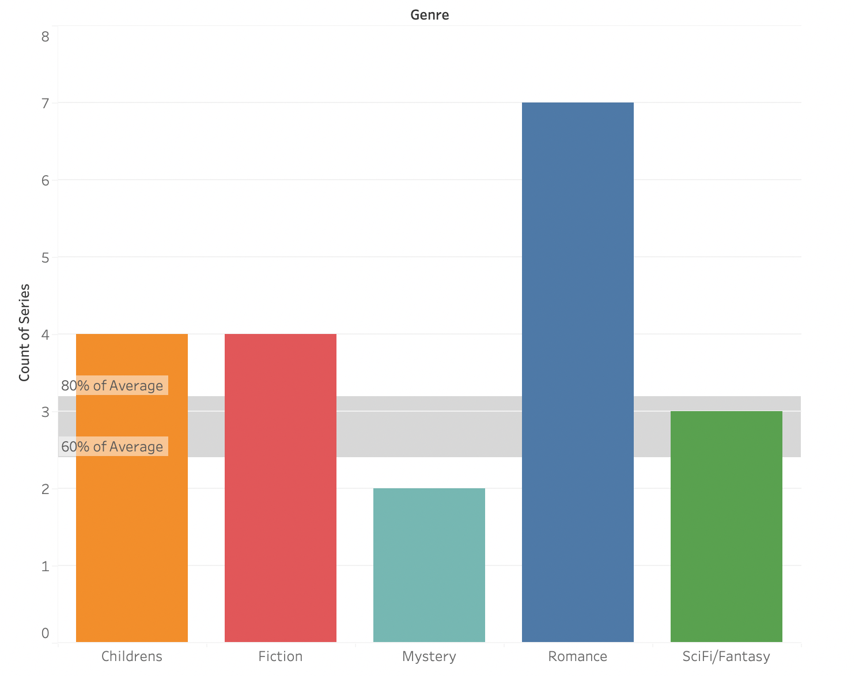
Count of series across the Genres
Romance genre has 7 series which is combined of Fiction and Sci-Fi/Fantasy
10
Data Visualization |Akshay Kailasa

